Slide 1
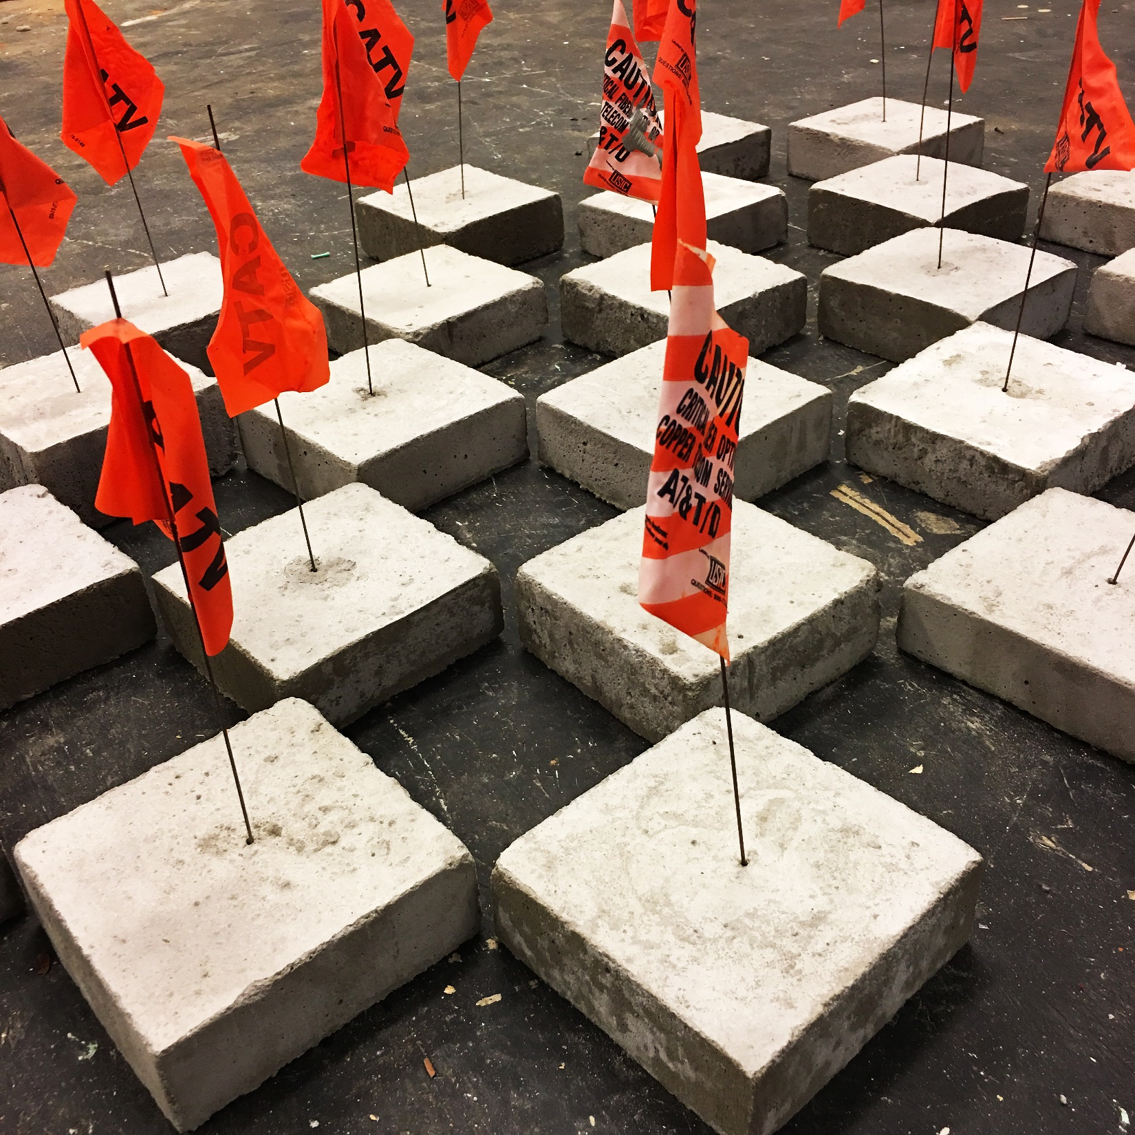
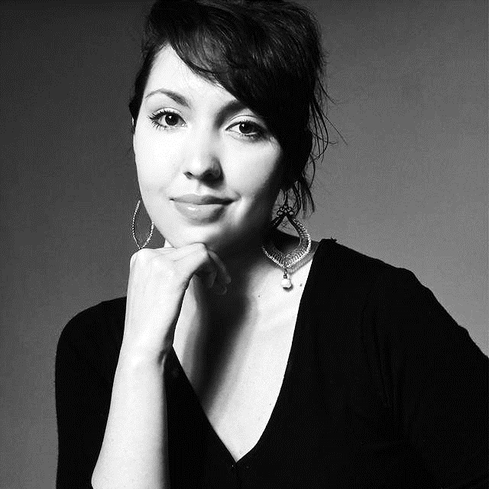
CARLA CONTRERAS
VISUAL ARTIST

Slide 2
My work examines the relation between urban development and the human condition. I am interested in analyzing and questioning the impact of a booming urban ecosystem over its inhabitants and their interactions within those transforming surroundings. Through a multidisciplinary approach that combines video installation, painting, drawing, and printmaking I intend to tackle societal challenges and hurdles such as the fragmentation of communities, sterilization of areas of the city, and homogenization of populations. The formal language and color palette of the work is drawn from the recognition and observation of visual information and marking systems in the utility sector and construction industry, as well as from an intimate and more personal processes and interactions with simple living organisms such as kidney bean sprouts that I grow in cotton balls.

Slide 3
2019

Slide 4
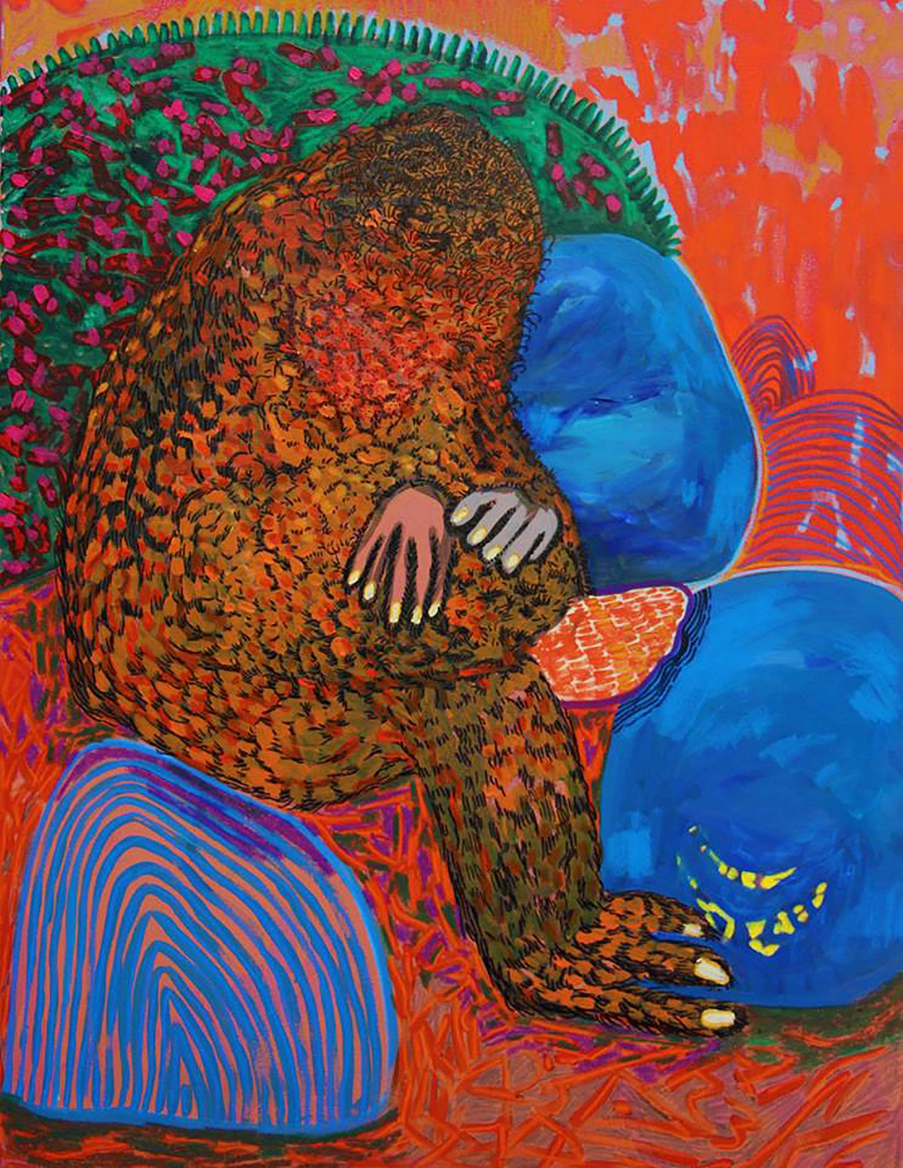
IKEA Bags, 2019, mixed media (acrylic, oil pastels, markers,
and pencils on canvas), 36” x 48”.

Slide 5
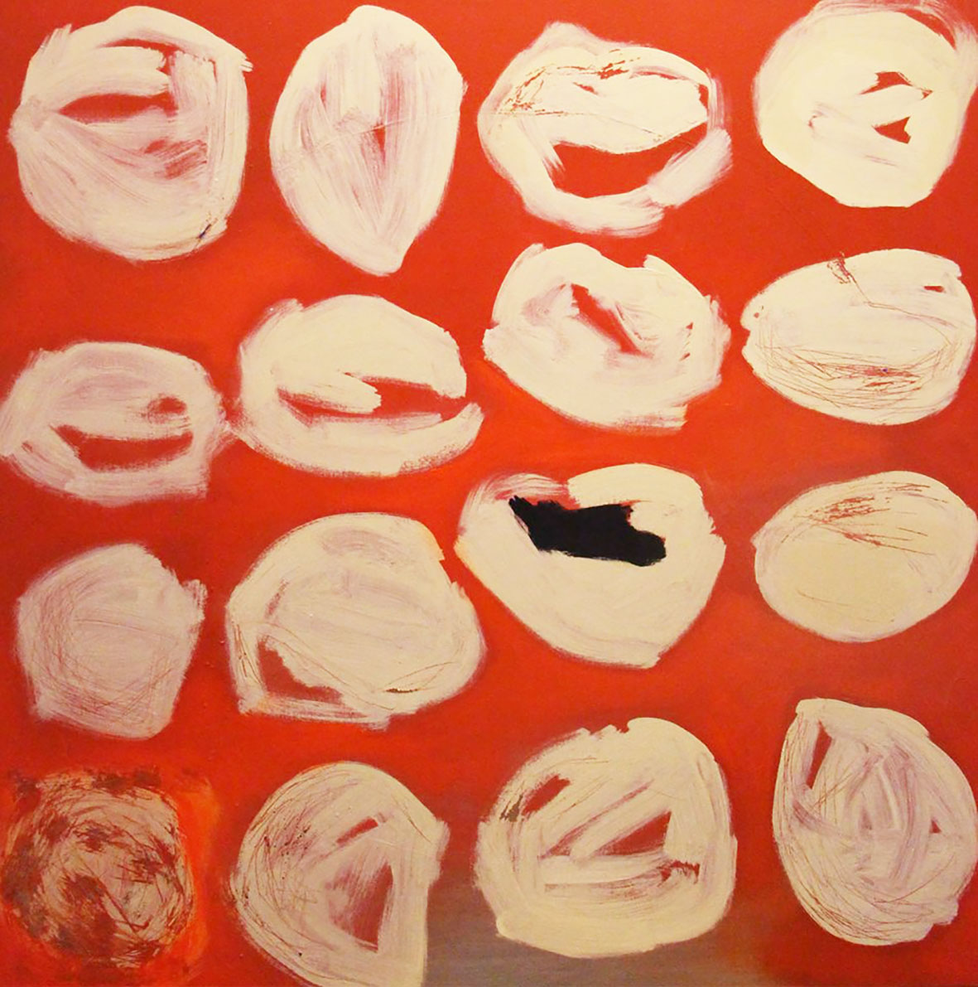
Rots, acrylic and spray paint on canvas, 48 x 48 inches, 2018.

Slide 6
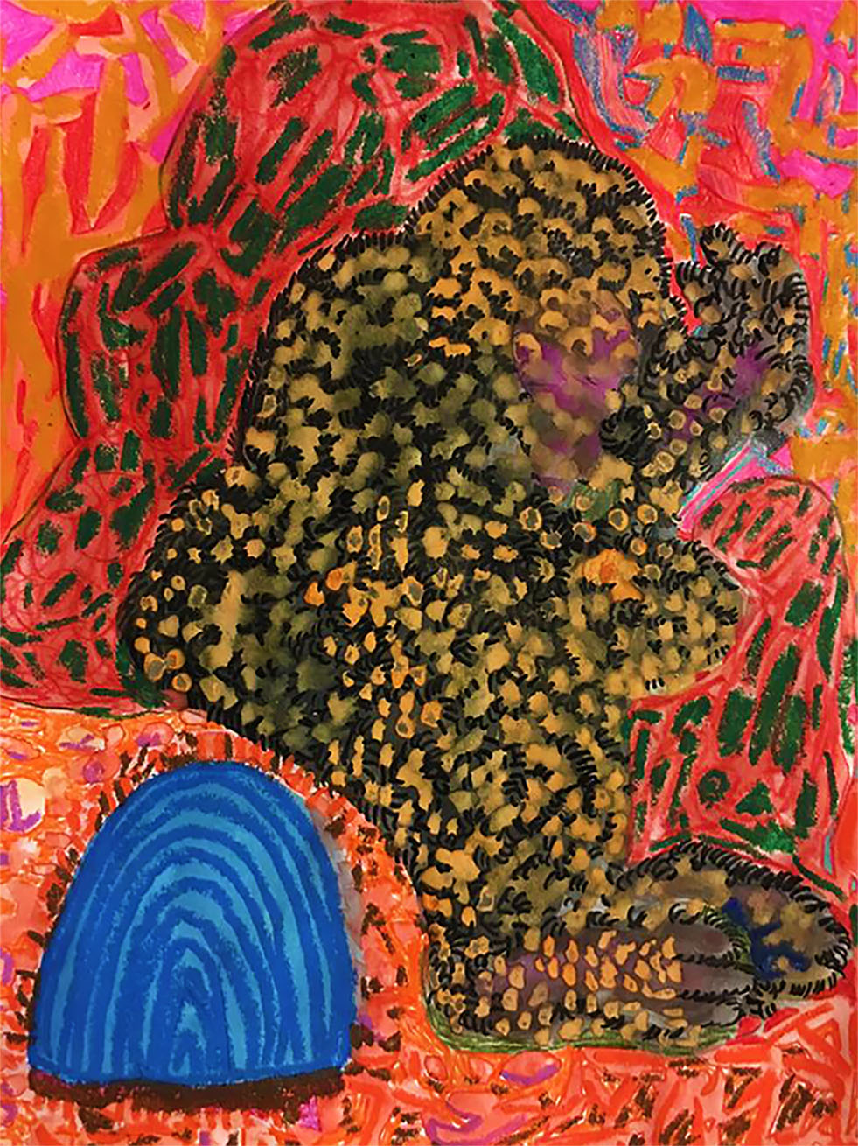
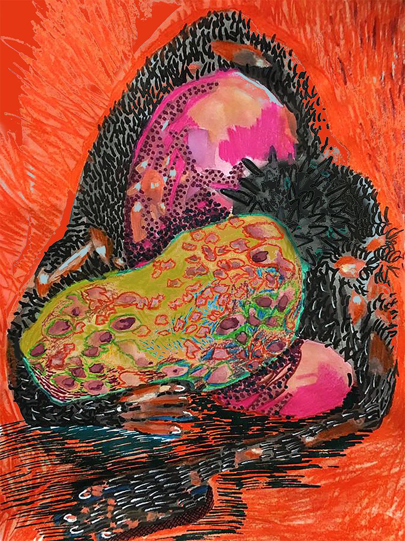
No Bench, 2019, mixed media (watercolor, oil pastels, and markers on paper), 17” x 21” each.

Slide 7
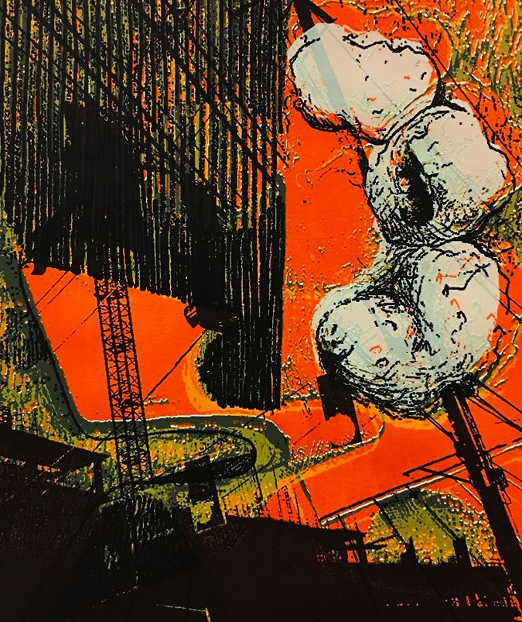
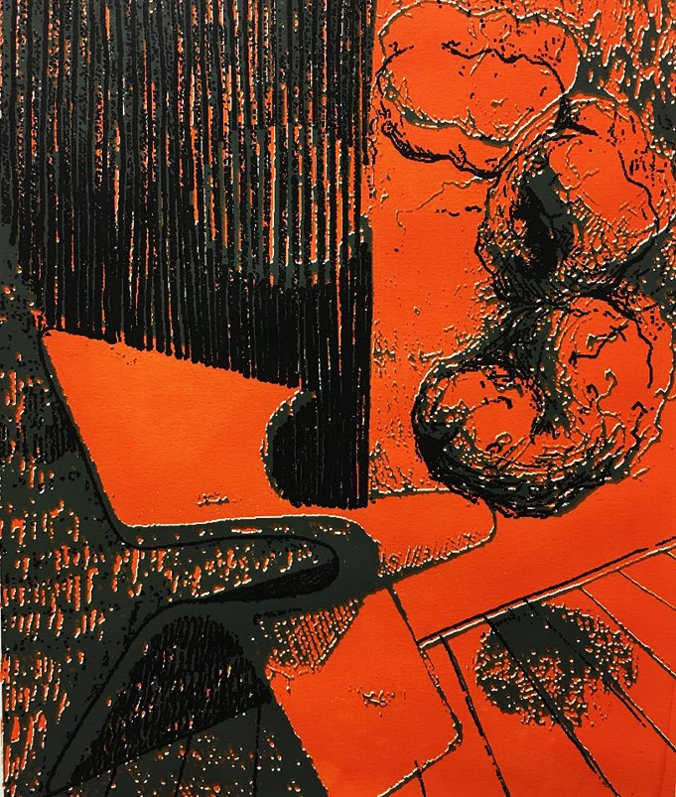
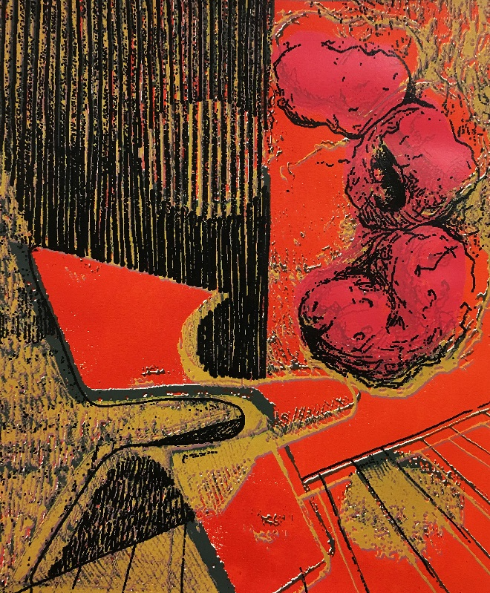
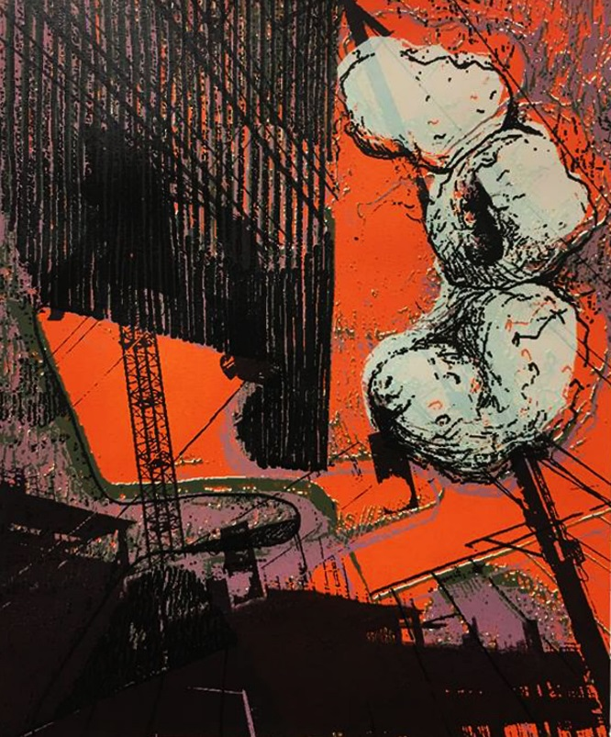
Lumped, screen-prints, 17” x 21” each, 2018-2019.

Slide 8
2018

Slide 9

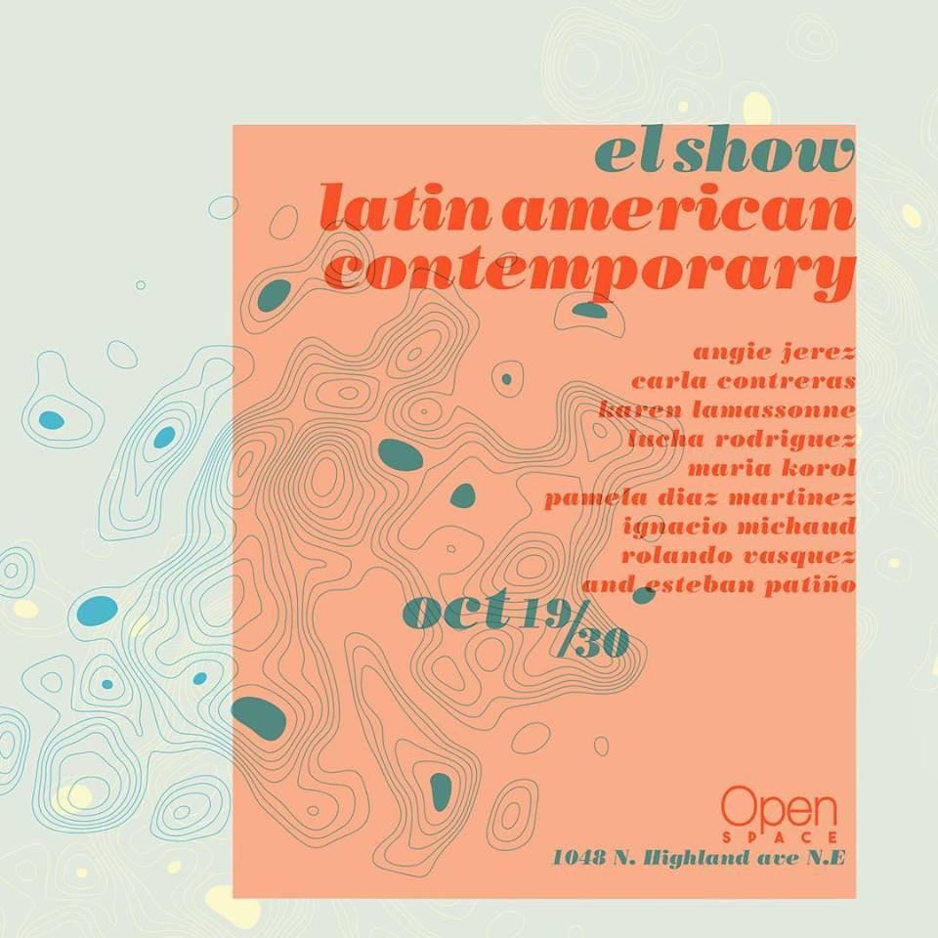
‘el show’ Latinamerican Contemporary
Curated by Esteban Patino

Slide 10
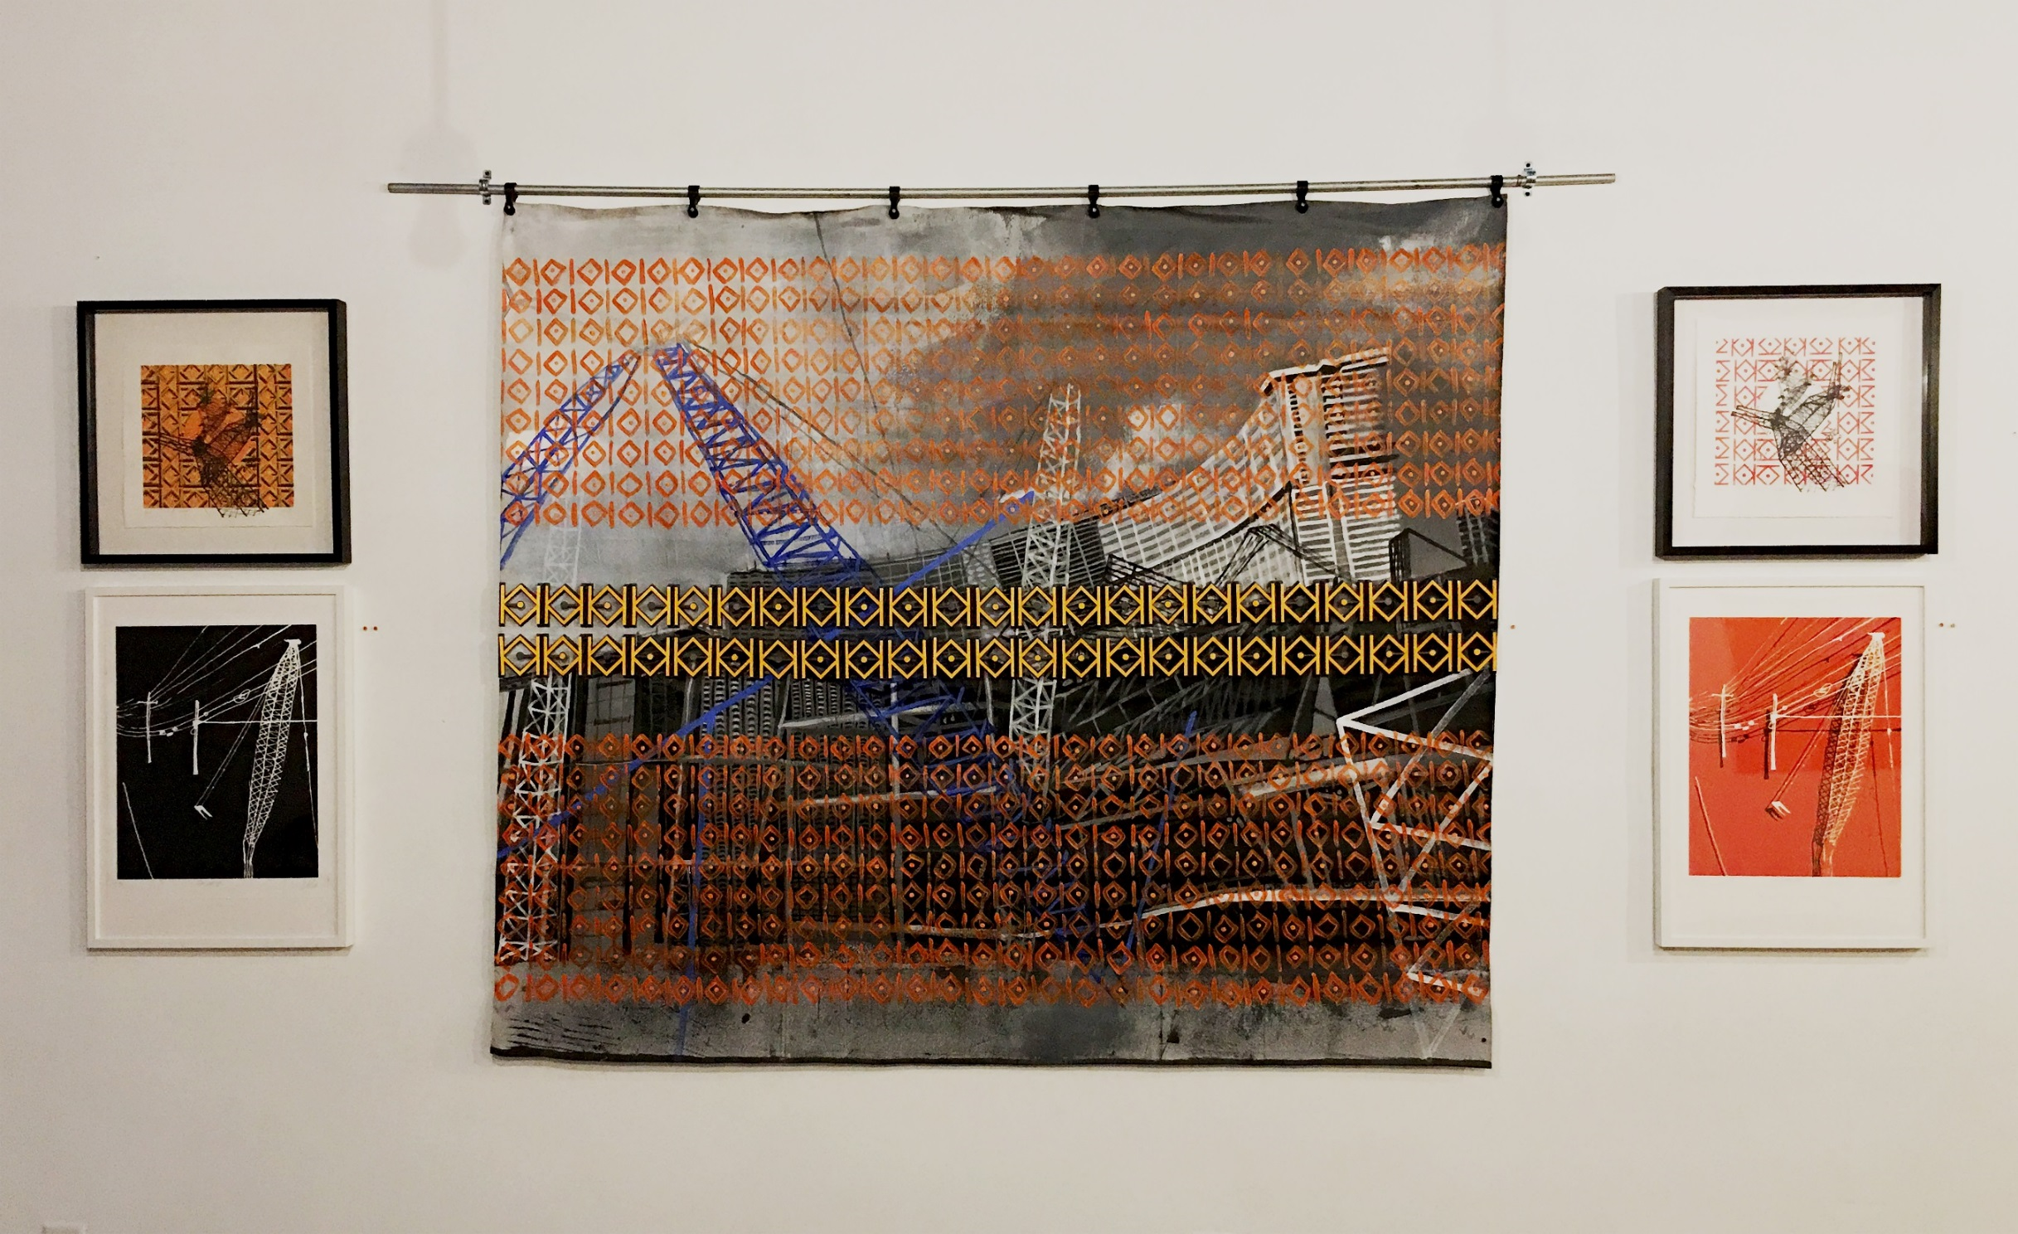

Slide 11
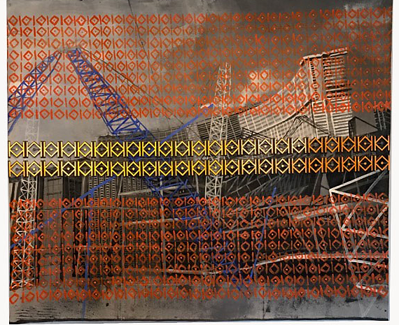
Gentry Site, mixed media (acrylic, 3D printed pieces, reflective tape on canvas). 70x96 inches, 2018.

Slide 12
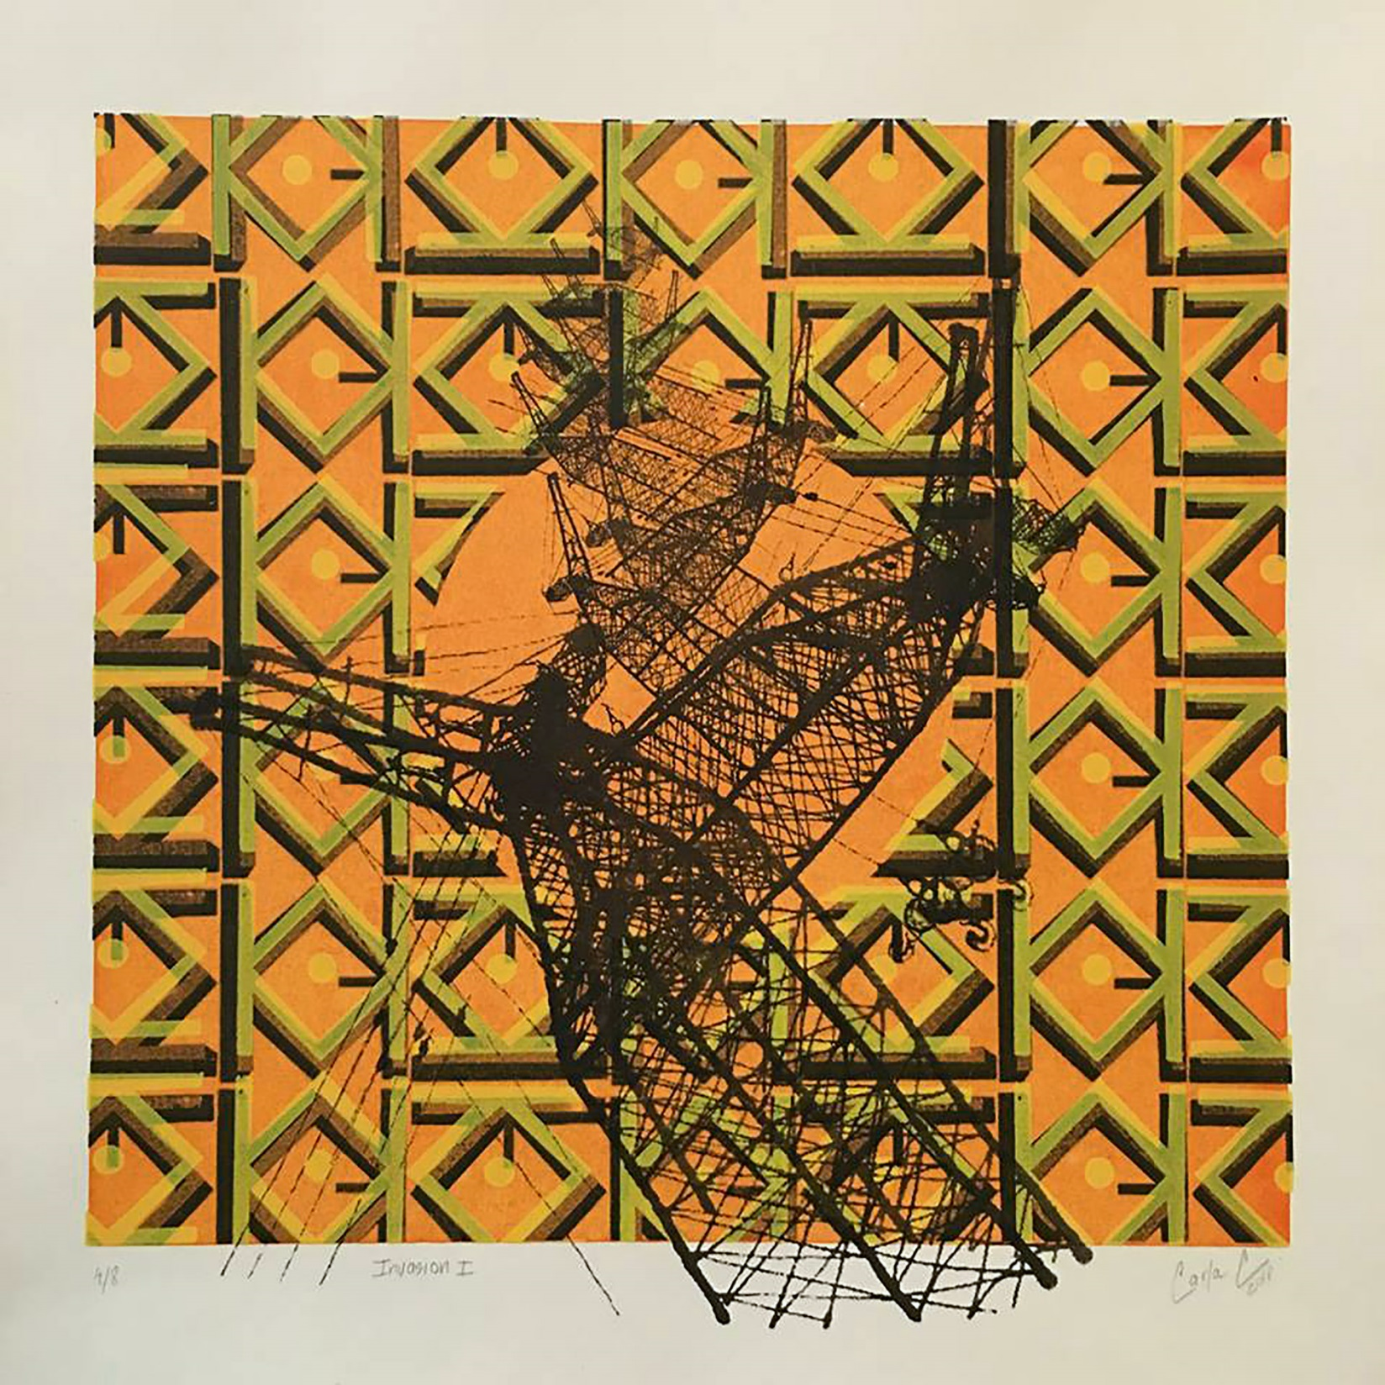
Invasion I, screenprint, 2018

Slide 13
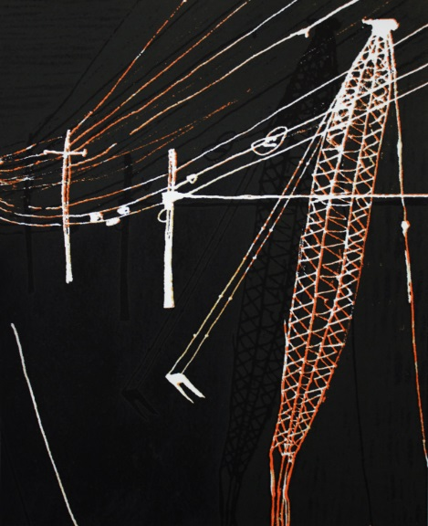
Black Crane Landscape, lithograph, 2018

Slide 14
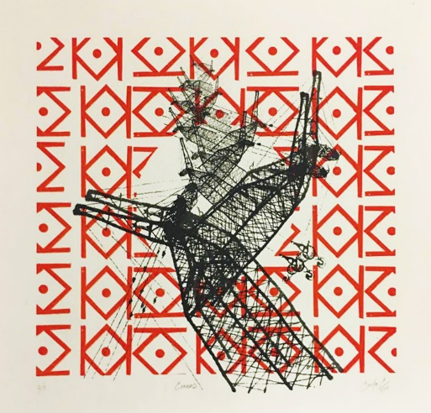
Cranes, screenprint, 2018

Slide 15
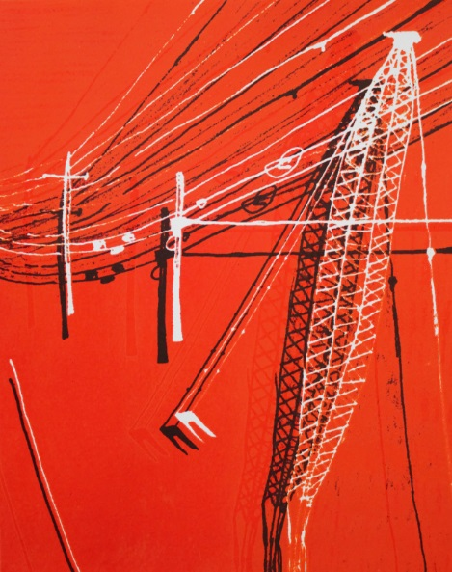
Red Crane Landscape, lithograph, 2018

Slide 16
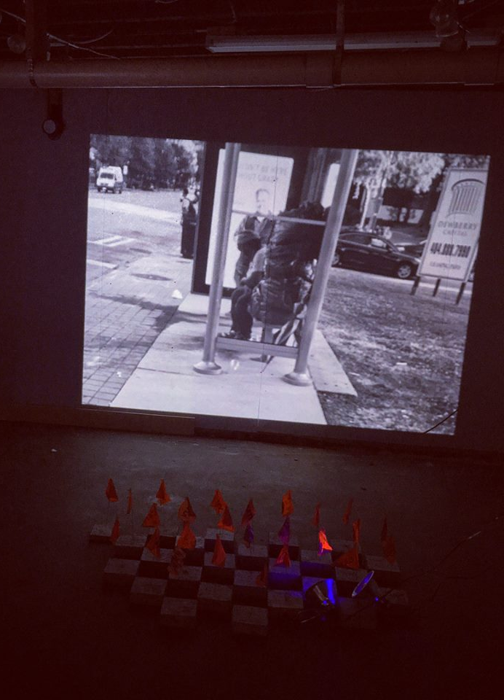
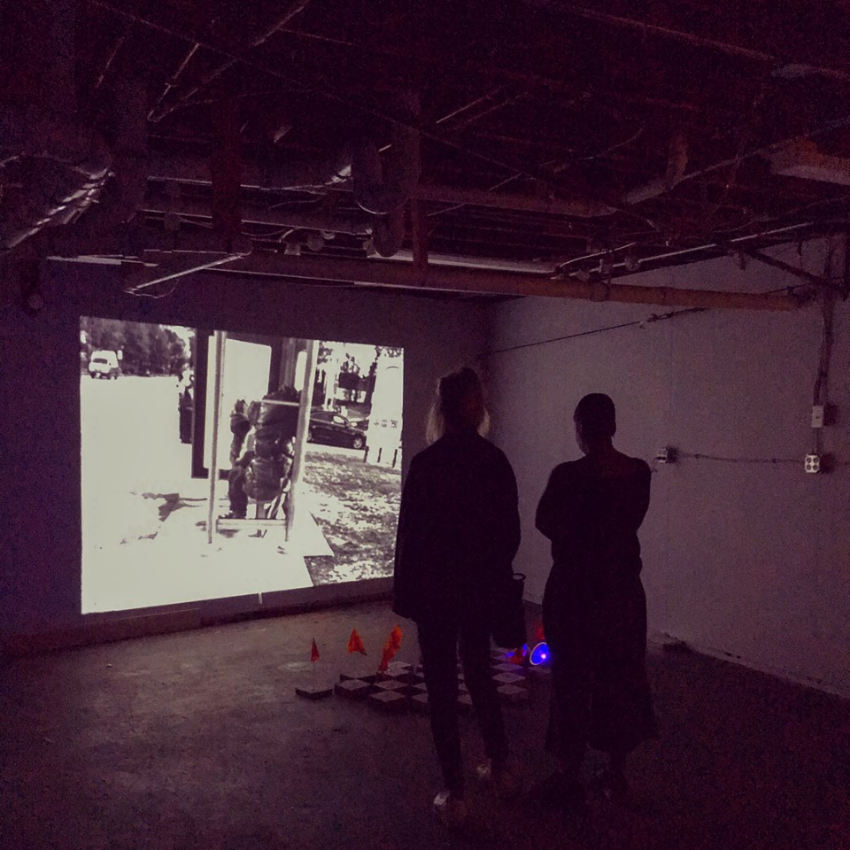
REMOVAL, Video Installation (cement blocks, marking flags, neon light, spray paint), 2018

Slide 17
Peachtree St NE@17th St NE. Marta bus stop bench with shed. One block away from the High Museum of Art. Homeless woman. Pile of IKEA bags. Cold day. Woman talking to herself. Woman playing with her hands. Sunny day. Woman staring into space. Woman rejecting spare change. Woman stretching her feet. Hot day. Woman swinging her body back and forth. Rainy day. Woman smiling to herself. Cloudy day. Woman rejecting food. Woman talking and smiling to herself. Woman playing with her hands. Sunny day. Woman staring into space. Windy day. Woman rejecting spare change. Woman stretching her feet. Hot day. Woman swinging her body back and forth. Rainy day. Woman smiling to herself…
…bus stop bench removed.

Slide 18
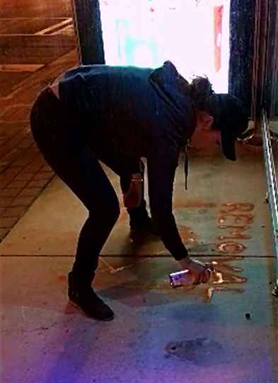
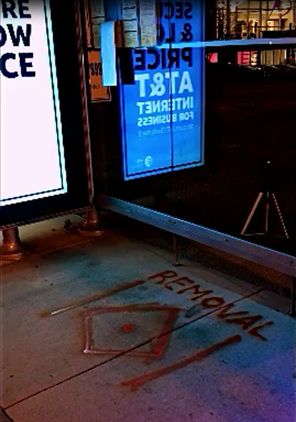
REMOVAL Intervention, Peachtree St NE@17th St NE. Marta bus stop.

Slide 19

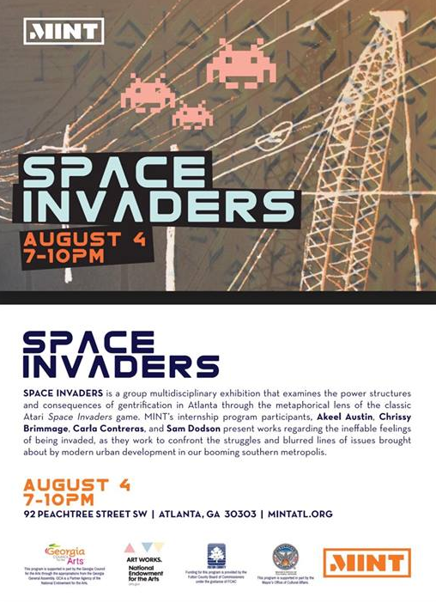
SPACE INVADERS
Mintern Show

Slide 20
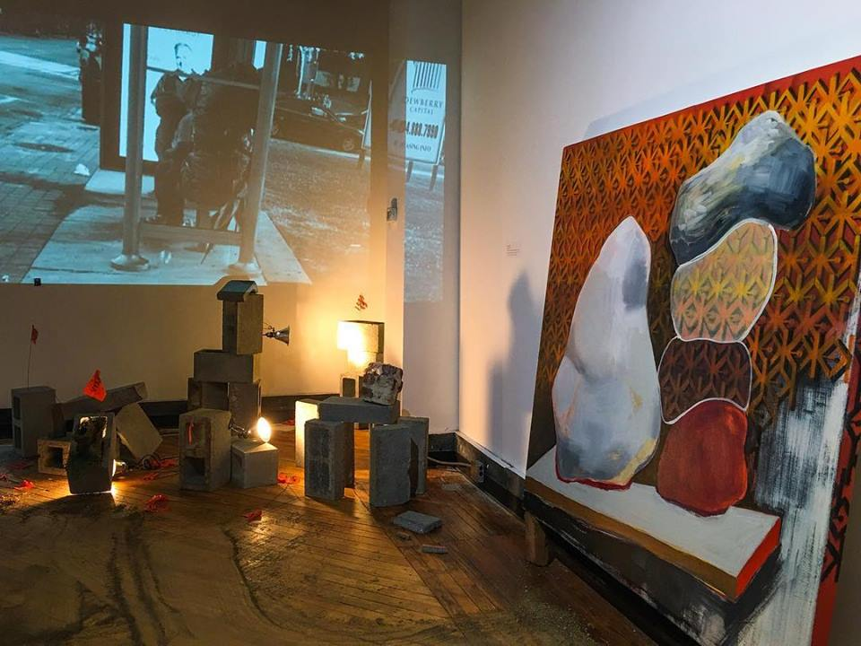
REMOVAL, Video installation (cinder blocks, marking flags, turf, dirt, bricks, rotten kidney bean sprouts in cotton balls, acrylic and spray paint painting, 2018

Slide 21
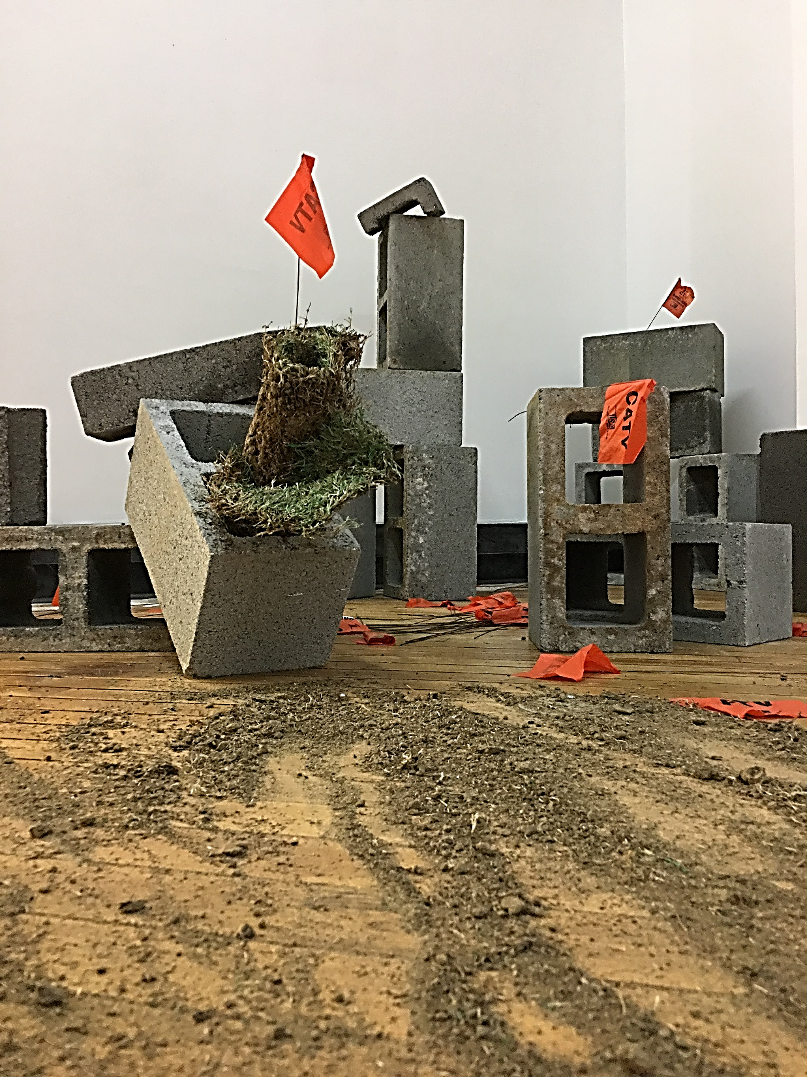
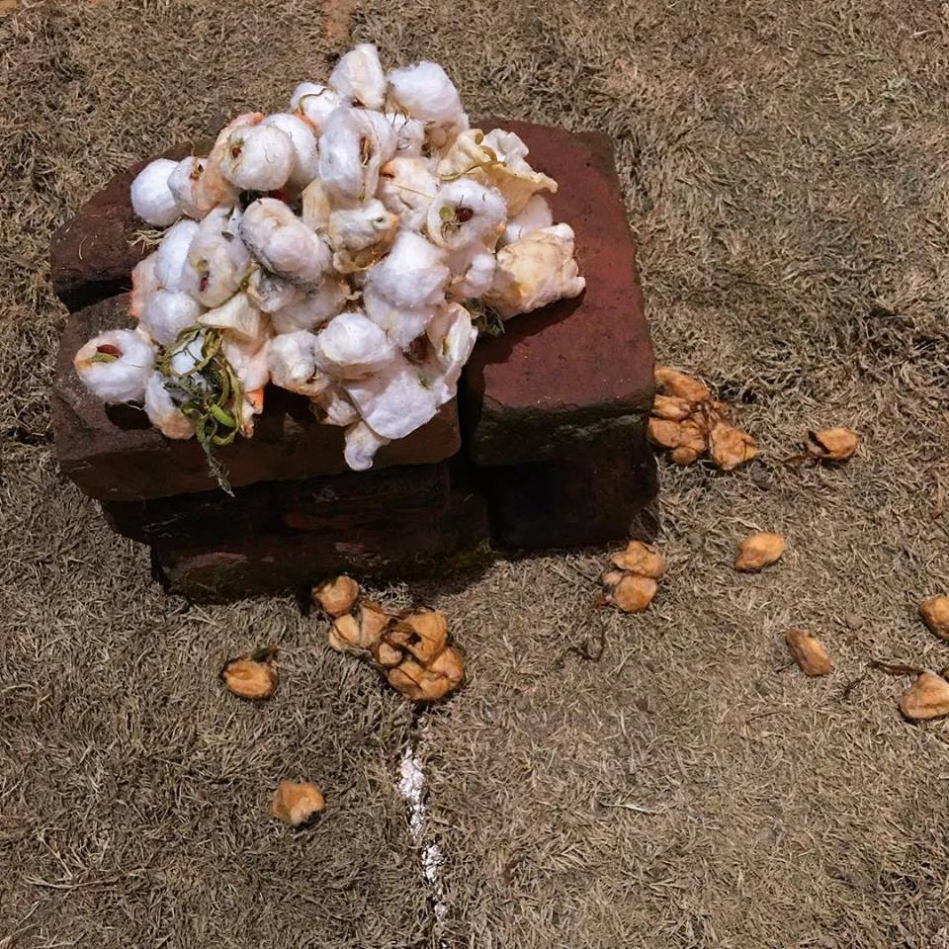

Slide 22
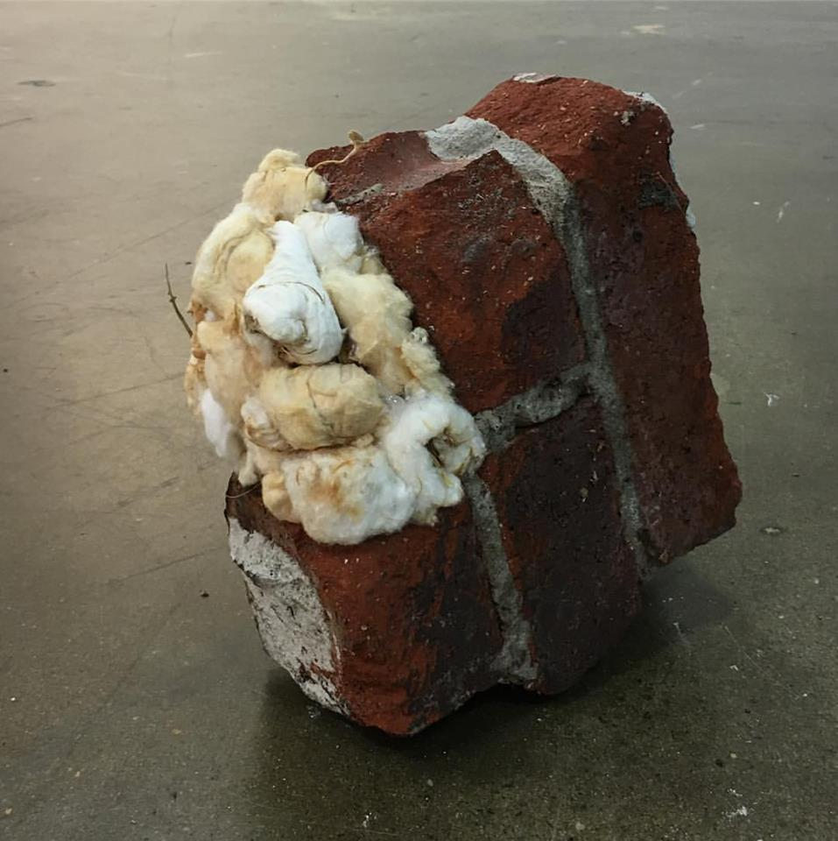

Slide 23
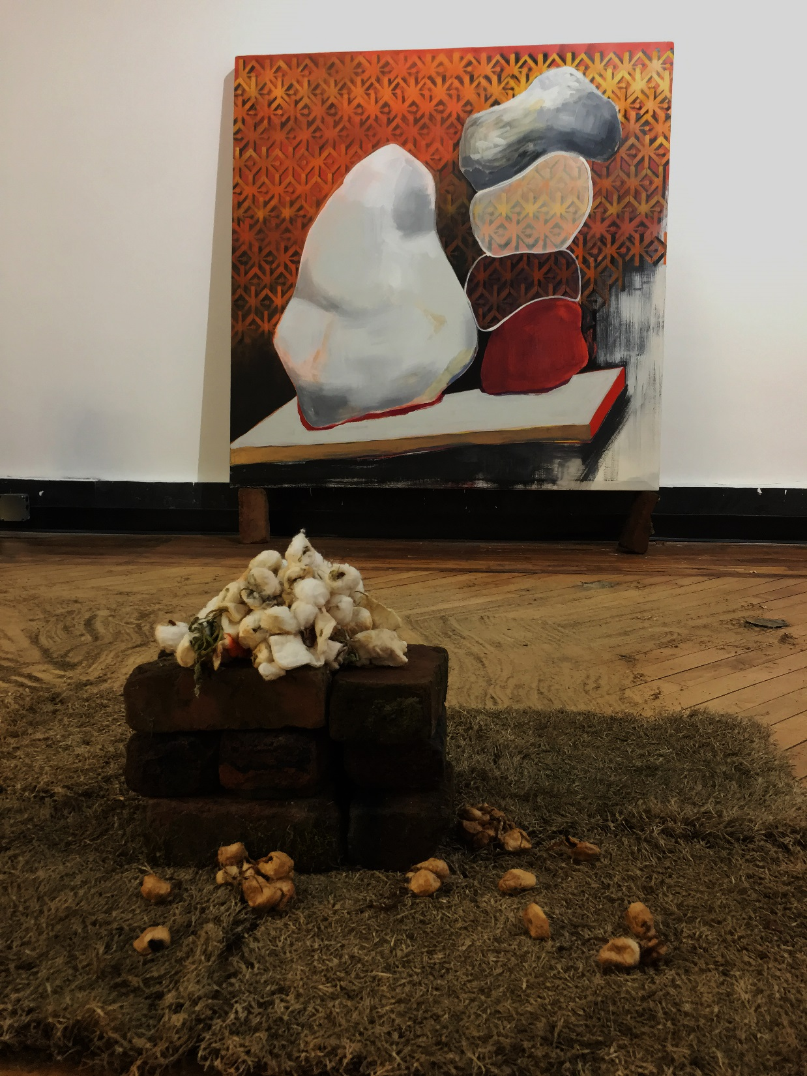
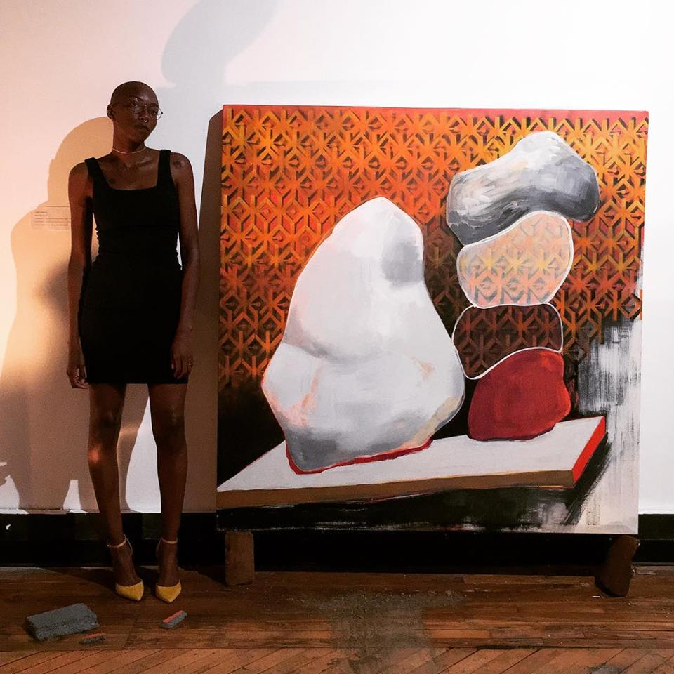

Slide 24
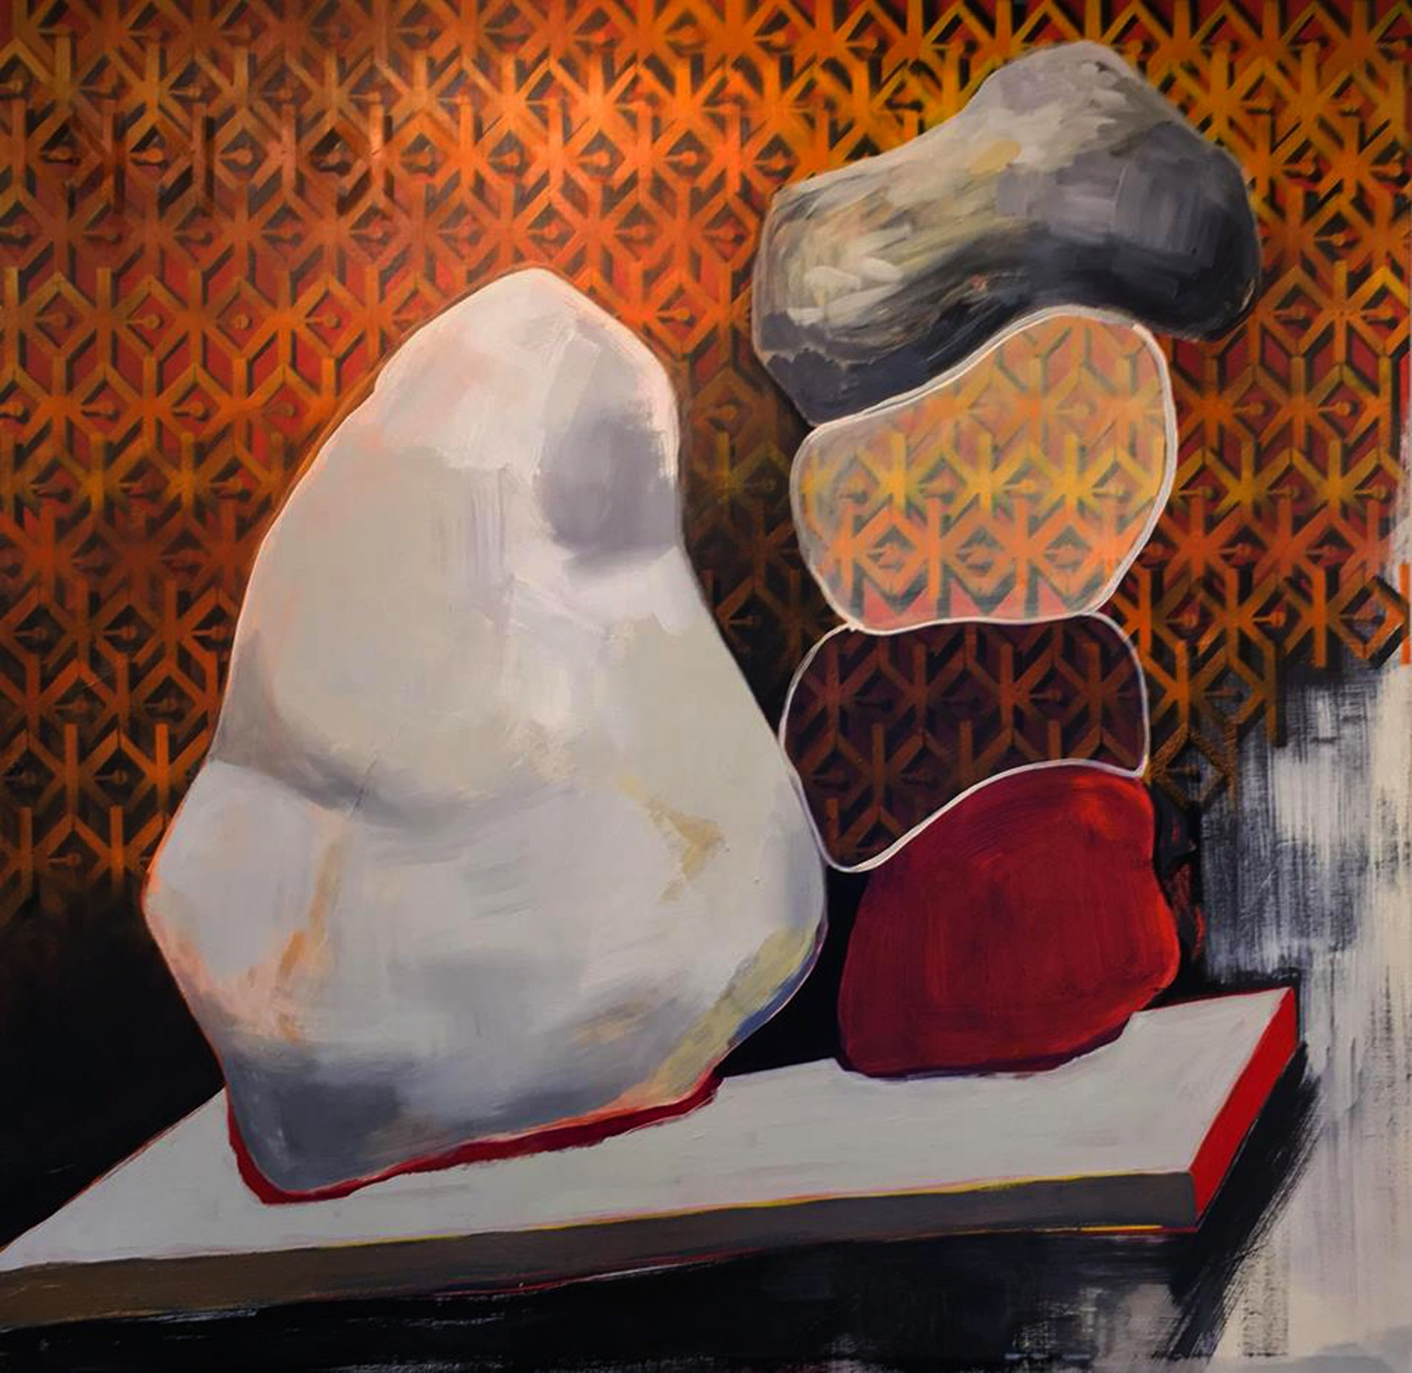
Lumps, acrylic and spray paint on canvas, 2018

Slide 25

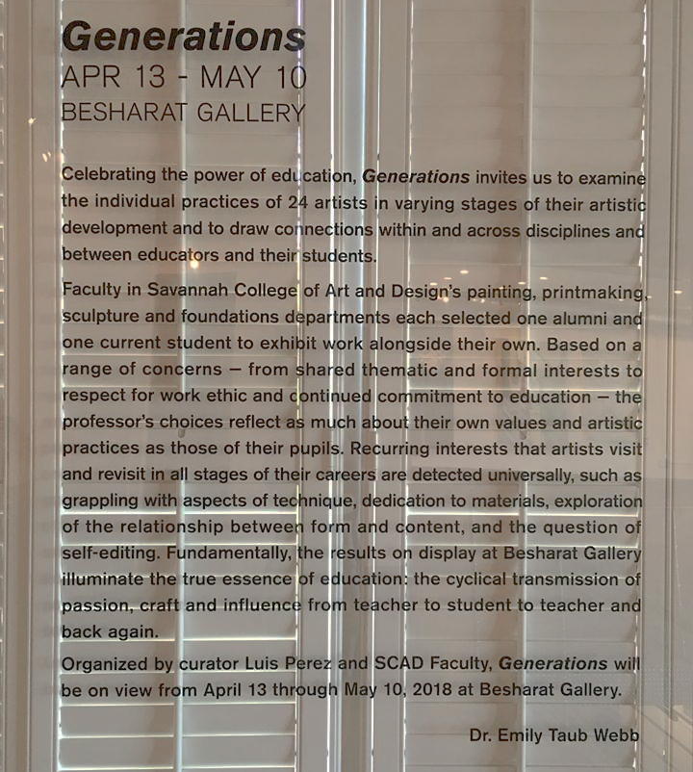
Generations
Curated by Emily Taub Webb

Slide 26
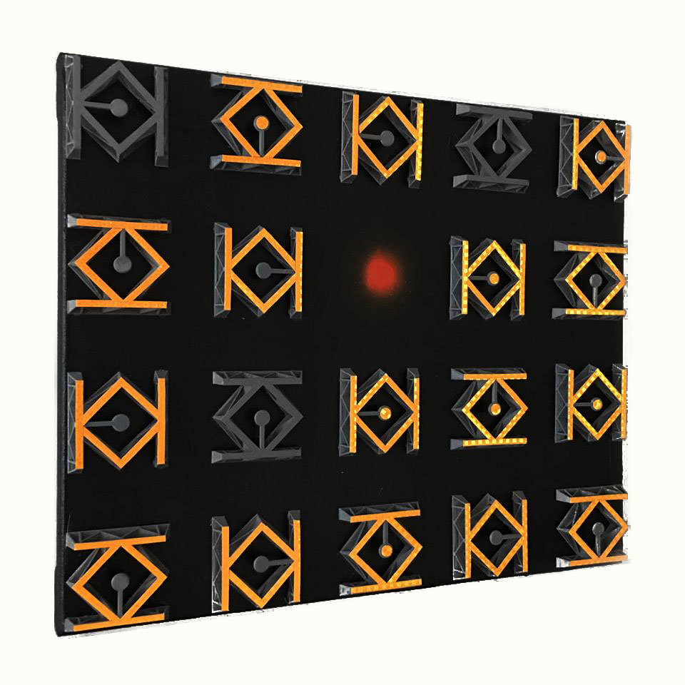
Invasive Marks, 3D printed pieces, reflective tape, acrylic, and spray paint on canvas, 2018

Slide 27
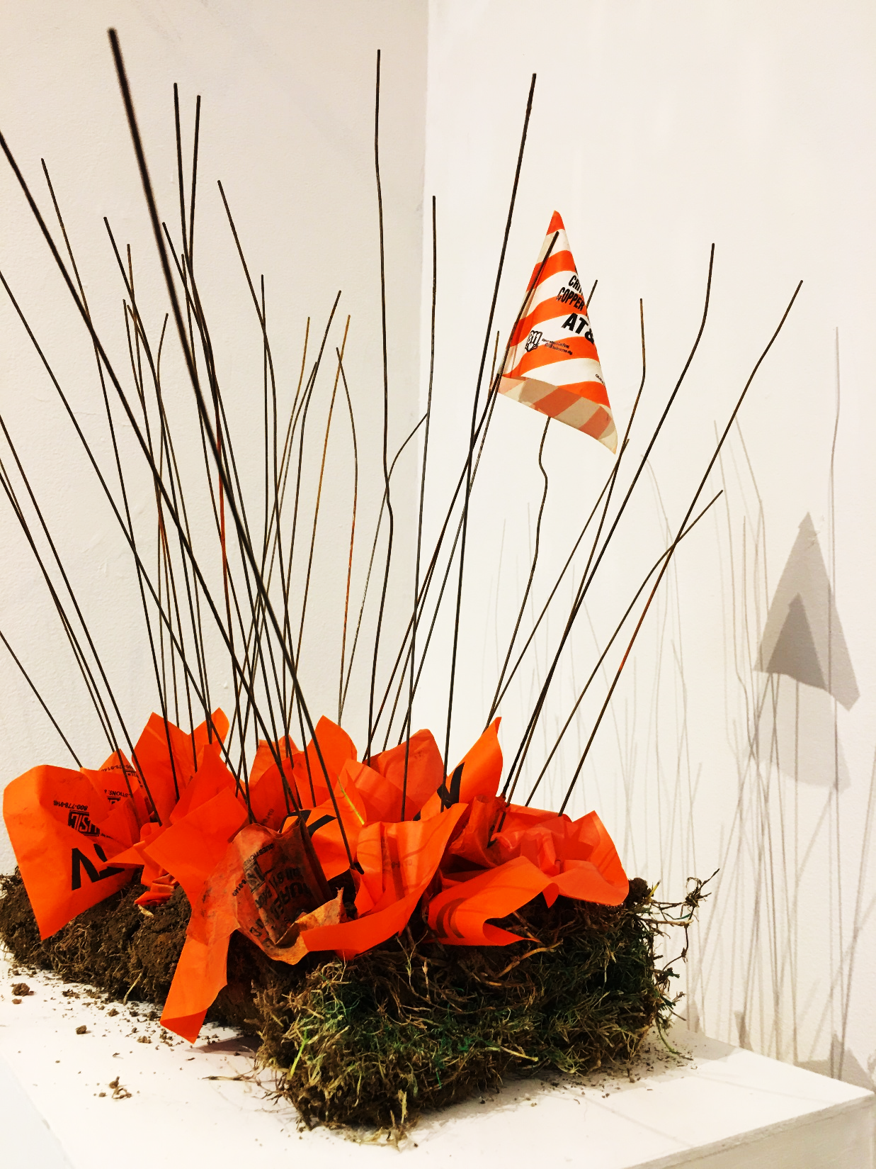
Bouquet, CATV marking flags, construction site turf and dirt, 2018

Slide 28

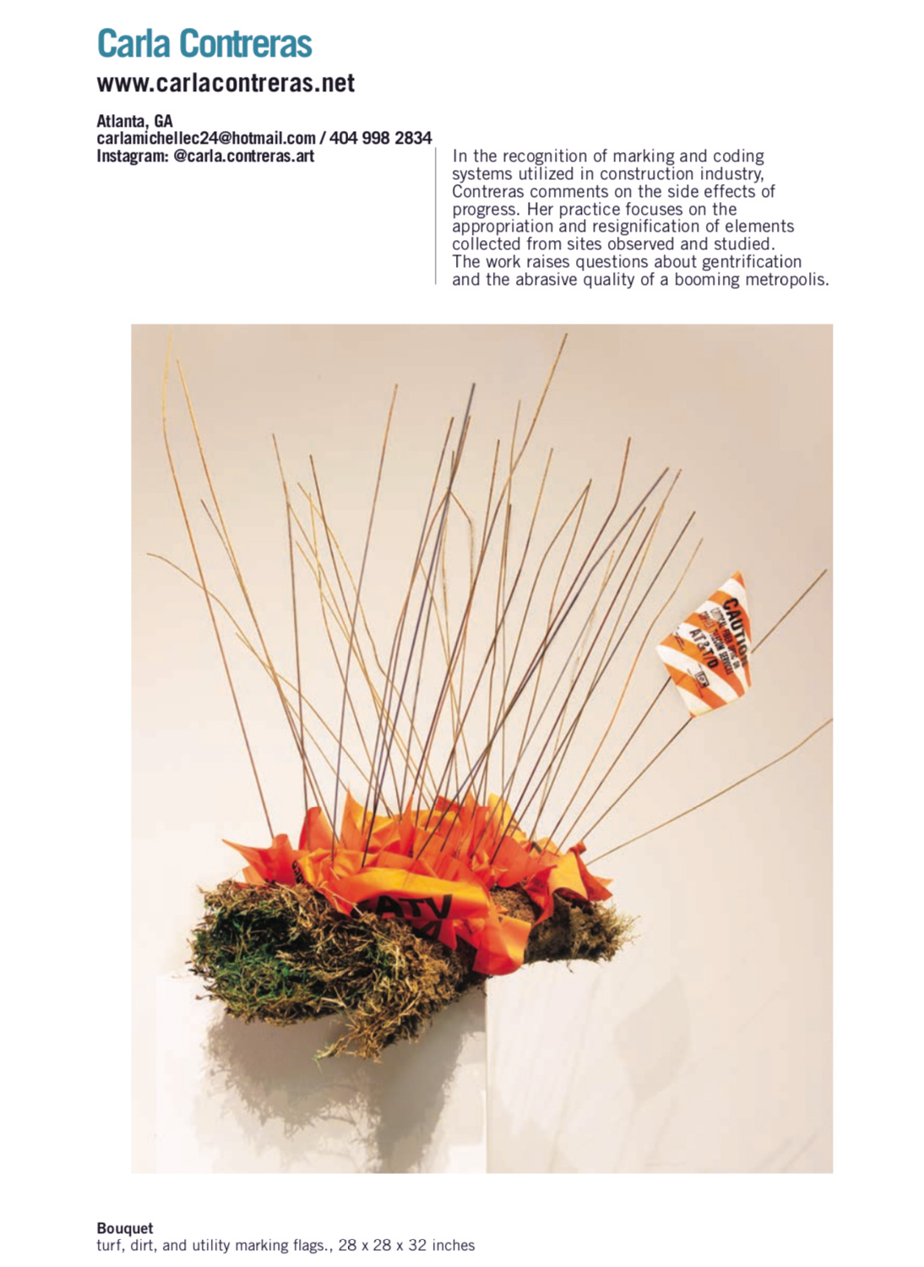
A Juried Selection of International Visual Artists
Curated By Lissa Crossman, Fitchburg Art Museum, Fitchburg, MA

Slide 29
2017

Slide 30

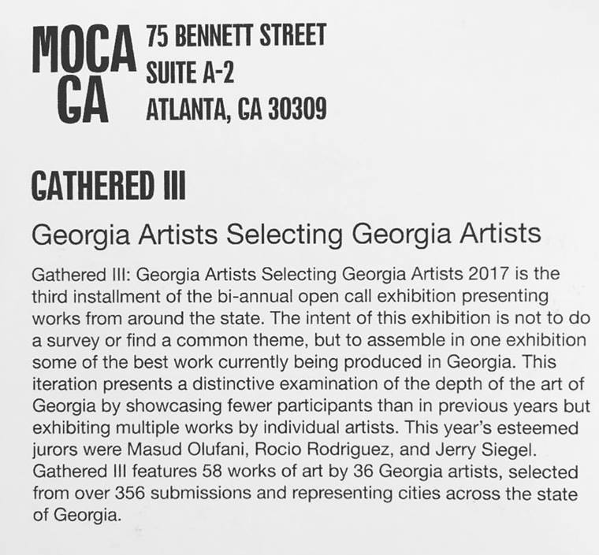


Slide 31
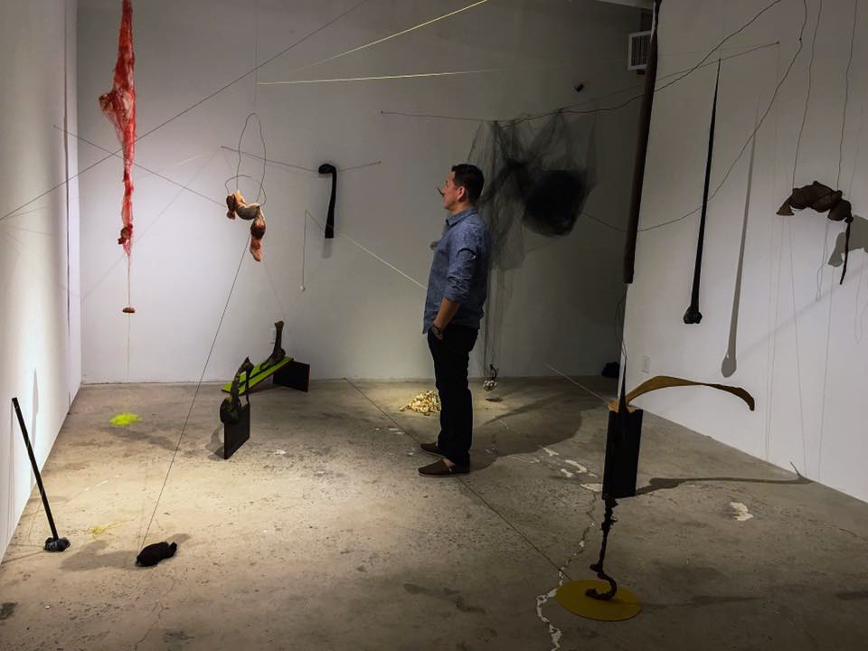
Jungle, Nylon tights, thread, yarn, clay, different types of wire, acrylic paint, wood, 2017.

Slide 32
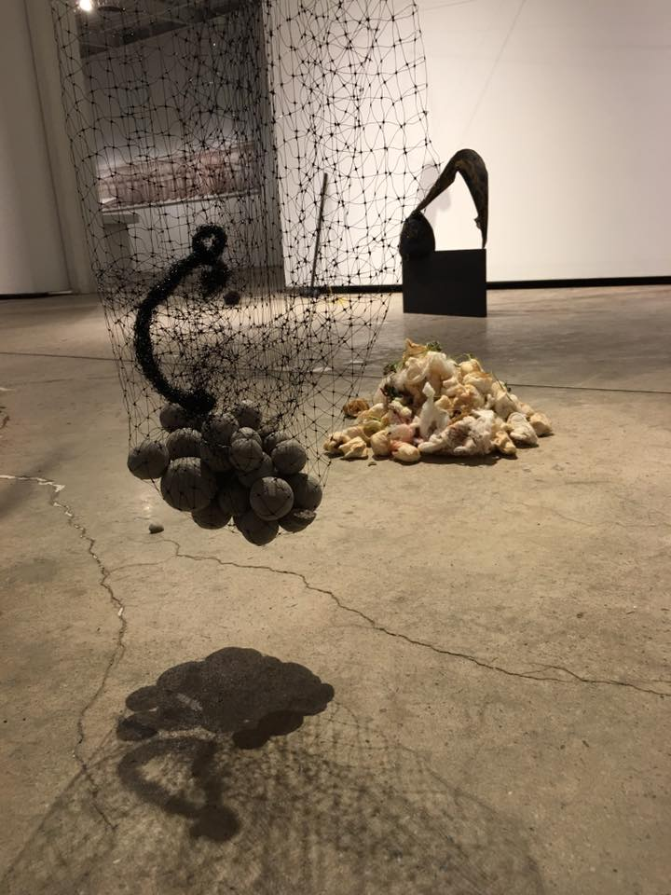
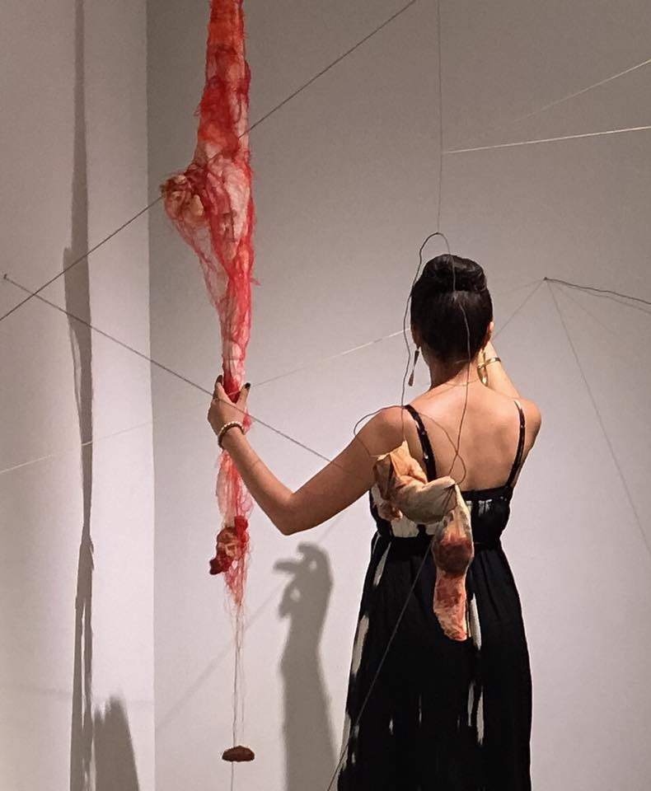

Slide 33
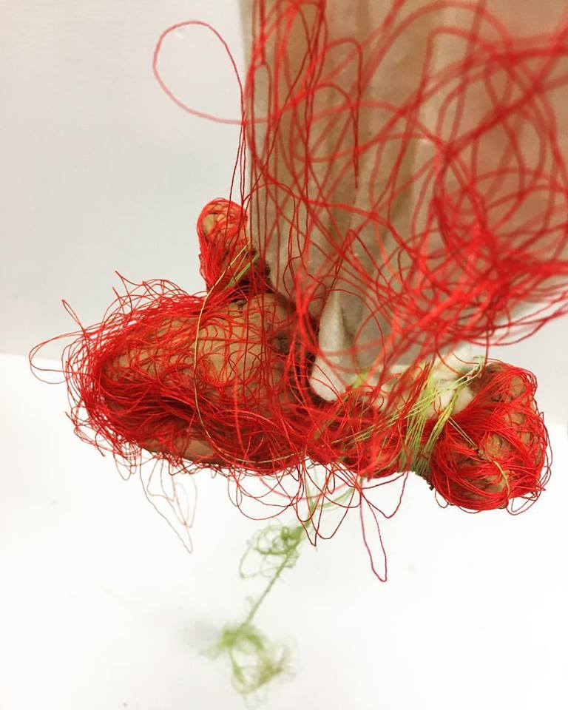
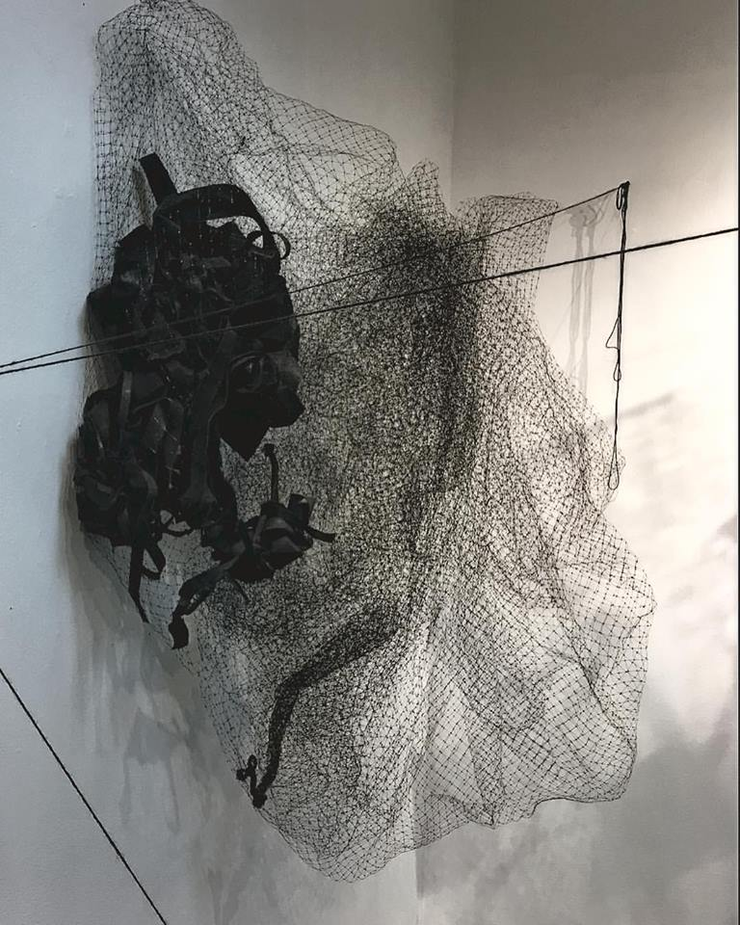

Slide 34
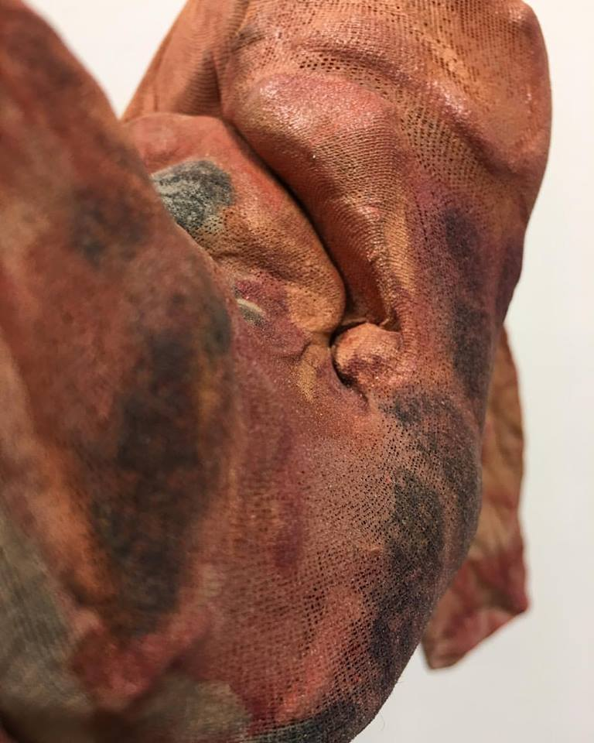
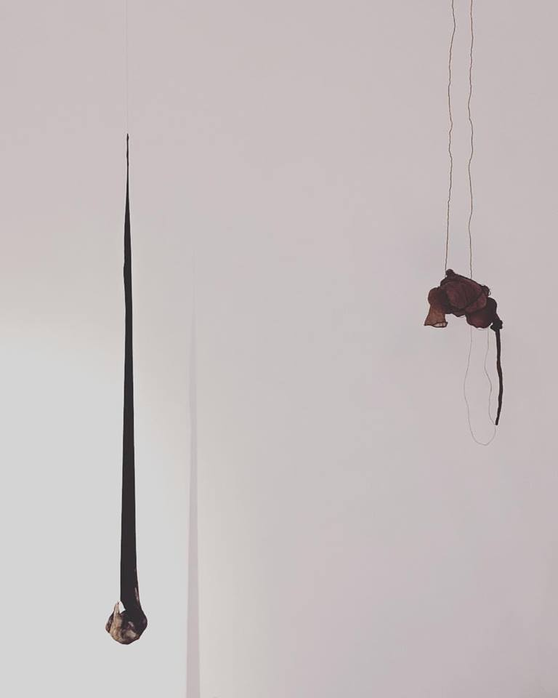

Slide 35
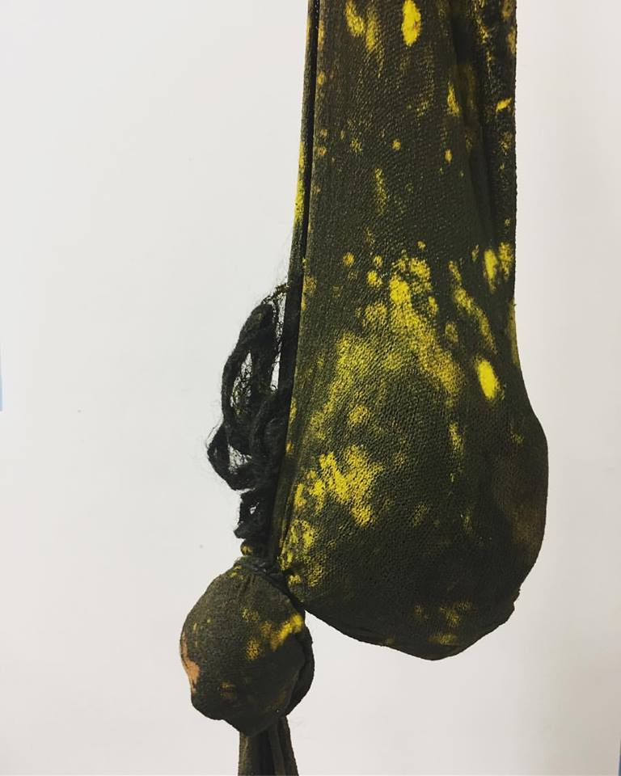
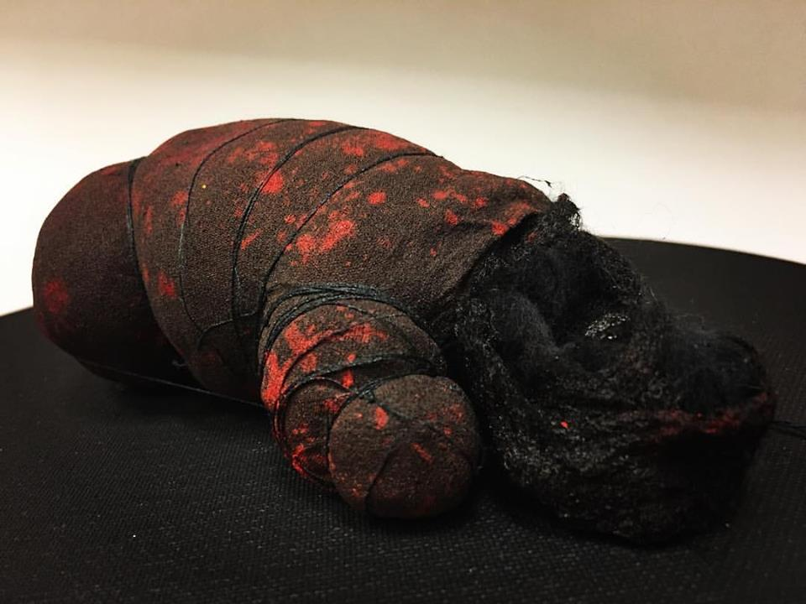

Slide 36
EXHIBITIONS
Solo Exhibitions
Carla Contreras Open Studio, 5C Gallery, Atlanta, GA. 2018
Carla Contreras Open Studio, 5C Gallery, Atlanta, GA. 2017
Carla Contreras Open Studio, 5C Gallery , Atlanta, GA. 2016
Fragment: Dissection and completeness, MasArte gallery, Quito, Ecuador. 2015
Two and Three Person Exhibitions
Space Invaders, Mint Gallery, Atlanta, Ga. 2018
ExpoArte USFQ, San Francisco Gallery, Quito, Ecuador. 2014
Senior Art Show, Elizabethtown Gallery, Elizabethtown, PA. 2013
Sculpture Art Show, USFQ gallery, Quito, Ecuador. 2012
Luis Medina Studio Art Show, Mariana de Jesus gallery, Quito, Ecuador. 2007
Luis Medina Studio Art Show, Villa Carmen Arts Center, Quito, Ecuador. 2005
Hugo Borja Studio Art Show, Nela Martinez gallery, Arts Center, Quito, Ecuador. 2002

Slide 37
Selected Group Exhibitions
Beyond Borders, curated by Althea Foster, The Johns Creek Arts Center,
Atlanta, Ga. 2018
‘El Show’ Latin American Contemporary , curated by Esteban Patino,
Open Space Gallery Project, Atlanta, Ga. 2018
Atlanta Artists Explore Materials and Process, curated by Joy C. Patty, 2018
The Lovett School Art Gallery, Atlanta, Ga.
Generations, curated by Tom Francis and Emily Webb, Besharat Contemporary,
Atlanta, Ga. 2018
Gathered III: Georgia Artists Selecting Georgia Artists, curated by 2017
Rocio Rodriguez, Masud Olufani, and Jerry Siegel, MOCA GA
Museum of Contemporary Art of Georgia, (catalogue). 2017
EngageMint Fundriaser, Mint gallery, Blue Mark Studios, Atlanta, Ga 2017
Open Studio Night, 5C Gallery, Atlanta, Ga 2017
Small Works, Gutstein gallery, Savannah, Ga 2016

Slide 38
Open Studio Night, 5C Gallery, Atlanta, Ga. 2016
Salon of July Ed. 57, Guayaquil Museum, Guayaquil, Ecuador. 2016
Course and Discourse: An Exhibition of Professor and Student Art Work.
State Museum of Pennsylvania, Harrisburg, Pa. 2013
Annual Juried Student Art Show, Elizabethtown College gallery, Elizabethtown, Pa. 2013

Slide 39
PUBLICATIONS AND TALKS
SCAD Spot Light Day Panelist, Savannah College of Art and Design, Atlanta Ga. 2018
Artist Talks Series, Savannah College of Art and Design, Atlanta, Ga. 2018
Studio Visit Magazine, Juried Artist Book, Boston, MA. 2018
ArtsAtl, Review: “Gathered III” makes for a rich experience, conservative in tone,
by Rebecca Brantley , Atlanta, GA. 2017
Burnaway, Feature :High Five: 5 Shows in the South, by BURNAWAY Staff, Atlanta, GA. 2017
Fine Print Magazine, Elizabethtown College, Elizabethtown, PA. 2013
Aula Magna Magazine, San Francisco University, Interview about the show at
The State Museum of art in Harrisburg, PA, United States, Quito, Ecuador. 2013
El Comercio Newspaper, Section Talents, Quito, Ecuador. 2009
La Casa INFORMATIVO CULTURAL Magazine, CCE Benjamín Carrión, Quito, Ecuador. 2007
Avant guard Magazine, Section People, Emerging artists, Quito, Ecuador. 2005
La Pandilla Magazine, Interview, Quito, Ecuador.

Slide 40
